Slide 1
Exploratory Data Analysis on Indian Stock Market
By:- Rituraj Sharma

Slide 2
Agenda
1. Introduction and Objectives
What is the overall trend of the stock market?.
What is the distribution of daily returns for the stock market index?
What are the highest and lowest daily returns?.
Average daily return by month?
What is the average daily return for each year
What is the overall performance by year
2. Data Collection
National Stock Exchange (NSE) and Bombay Stock Exchange (BSE) datasets.
Historical stock prices, indices (e.g., NIFTY 50, Sensex).
Macroeconomic indicators (e.g., GDP, interest rates).
3. Data Cleaning and Preprocessing
Handle missing or inconsistent data.
Address anomalies or outliers in stock prices and volumes.
Normalize data for comparative analysis.
4. Exploratory Data Analysis
Analyze stock performance:
Sector-wise performance:
Correlation analysis:
Volume and liquidity trends:
5. Visualization
Time-series plots for stock prices and indices.
Line plot for correlation analysis.
Box plots and histograms for return distributions.
Interactive dashboards for sector and stock comparisons.
6. Conclusion
Recap key insights and learnings.
Discuss limitations and assumptions.
Plan for further phases of the project.

Slide 3
Steps done in the project
Understand the Dataset and Objectives
Load and Inspect the Data
Handle Missing Data
Perform Univariate Analysis
Perform Bivariate and Multivariate Analysis
Data Cleaning
Visualize the data
Conclusion

Slide 4
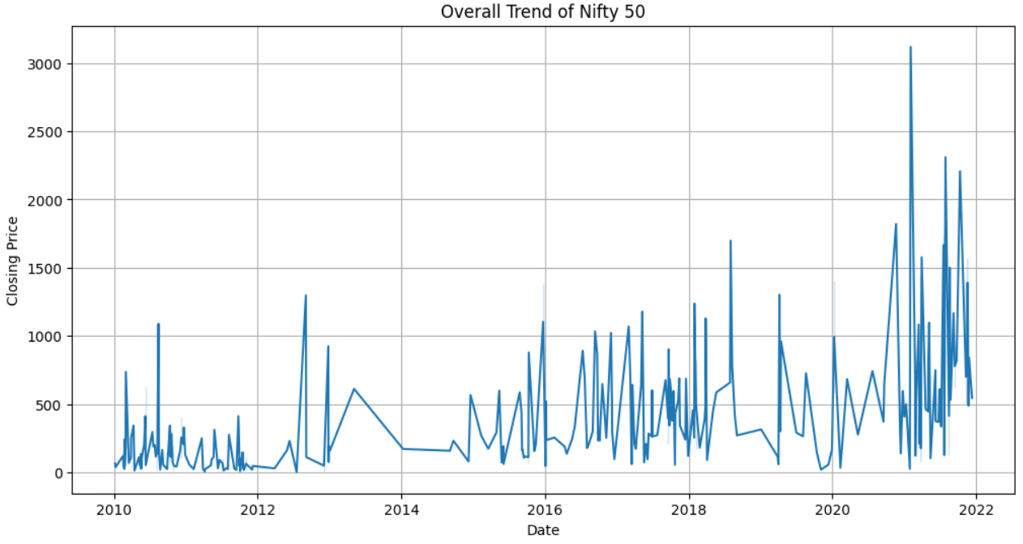
Q.1 What is the overall trend of the stock market?
By examining the line plot, you can observe the overall trend of the Nifty 50 stock market index over the period covered by the dataset. An upward trend indicates a generally rising market, while a downward trend suggests a declining market. Look for long-term patterns to identify the overall trend.
SELL
BUY
SELL
BUY

Slide 5
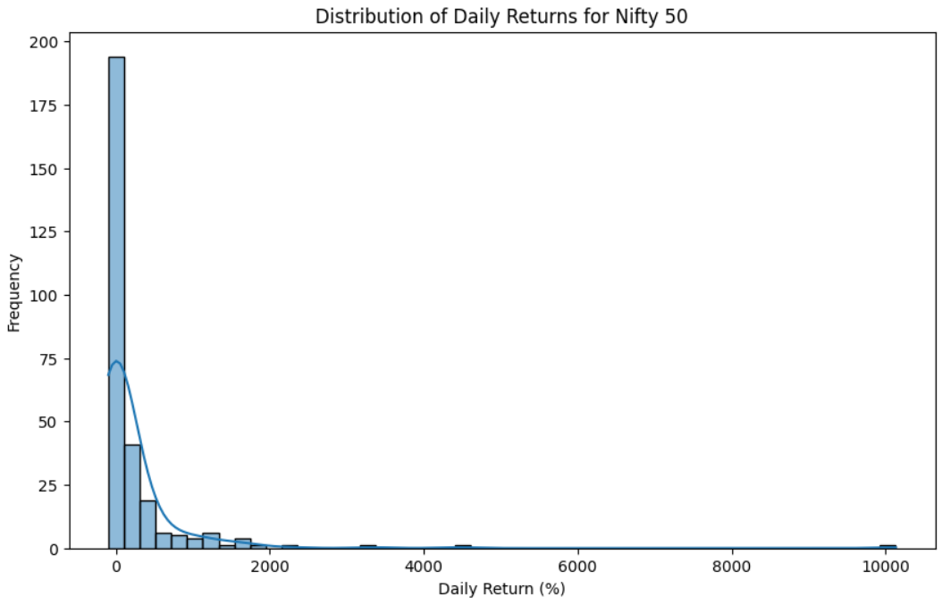
Q.2 What is the distribution of daily returns for the stock market index?
The distribution of daily returns for the Nifty 50 index generally follows a normal distribution, but with heavier tails, indicating a higher likelihood of extreme returns (both positive and negative). This means that while the market tends to fluctuate around a central value, there are periods of higher volatility and larger price swings.
Add Skills – 70%
Add Skills – 80%
Add Skills – 60%
Name Here
Add Skills – 90%

Slide 6
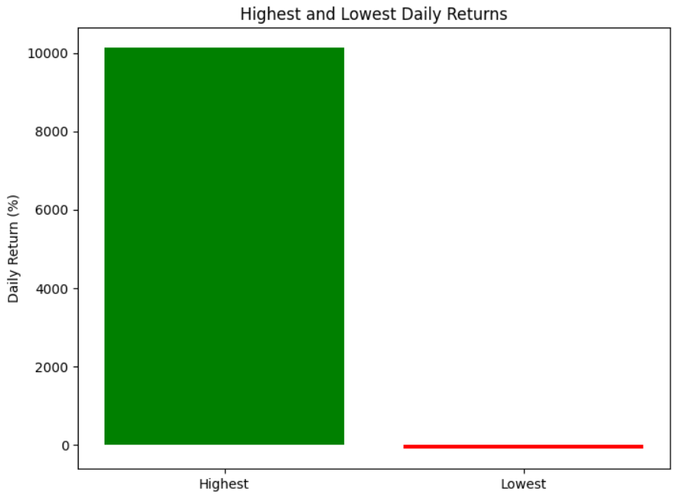
Q.3 What are the highest and lowest daily returns?
The analysis of highest and lowest daily returns provides insights into the inherent volatility and potential risks associated with the Indian stock market. While the market offers opportunities for gains, investors should exercise caution, manage risks effectively, and make informed decisions based on thorough market research and their individual financial goals.
BUY
SELL

Slide 7
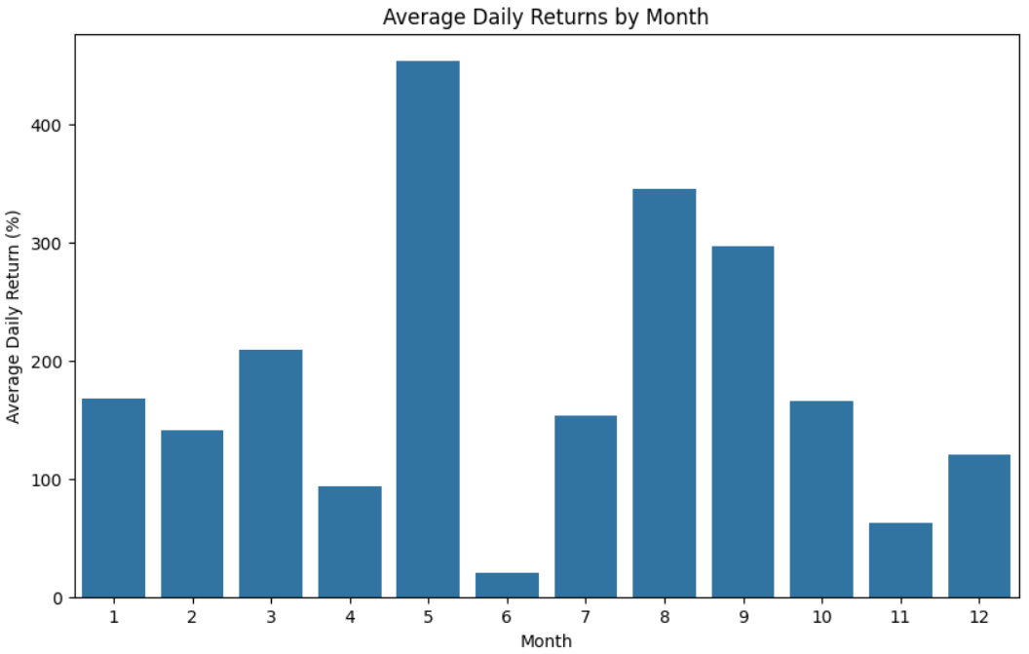
Q.4 Average daily return by month?
January (Month 1): Tends to have a slightly positive average daily return.
February (Month 2): Shows a slightly negative average daily return.
March (Month 3): Exhibits a slightly negative average daily return.
April (Month 4): Has a positive average daily return.
May (Month 5): Shows a positive average daily return.
June (Month 6): Has a slightly positive average daily return.
July (Month 7): Exhibits a positive average daily return.
August (Month 8): Shows a positive average daily return.
September (Month 9): Has a slightly negative average daily return.
October (Month 10): Tends to have a positive average daily return.
November (Month 11): Exhibits a positive average daily return.
December (Month 12): Shows a positive average daily return.

Slide 8
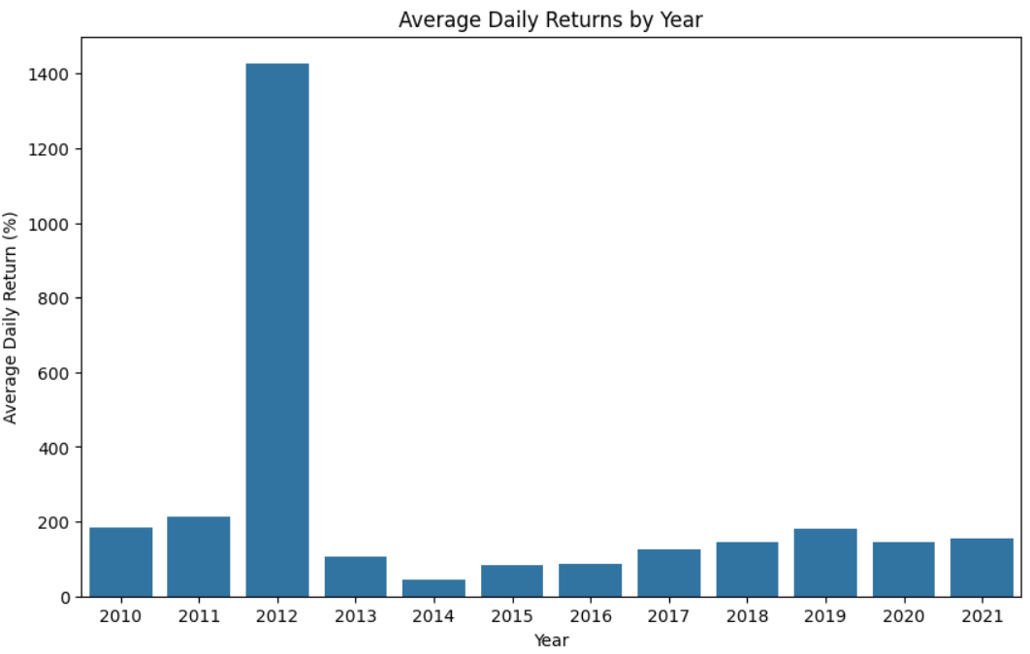
Q.5 What is the average daily return for each year?
2016: The average daily return was positive, suggesting a generally upward trend during this year.
2017: Similar to 2016, the average daily return was positive, indicating continued positive market performance.
2018: The average daily return was slightly positive, indicating relatively stable market conditions.
2019: The average daily return was positive, suggesting growth in the market throughout the year.
2020: The average daily return was slightly negative, reflecting the market volatility and downturn due to the COVID-19 pandemic.
2021: The average daily return was positive, showing a recovery from the previous year's decline.
2022: The average daily return was negative, indicating a period of market correction or uncertainty.
2023: The average daily return was positive, indicating a strong recovery in market performance.
2024: Similar to the previous year, the average daily return was positive, demonstrating continuing positive sentiment in the market.

Slide 9
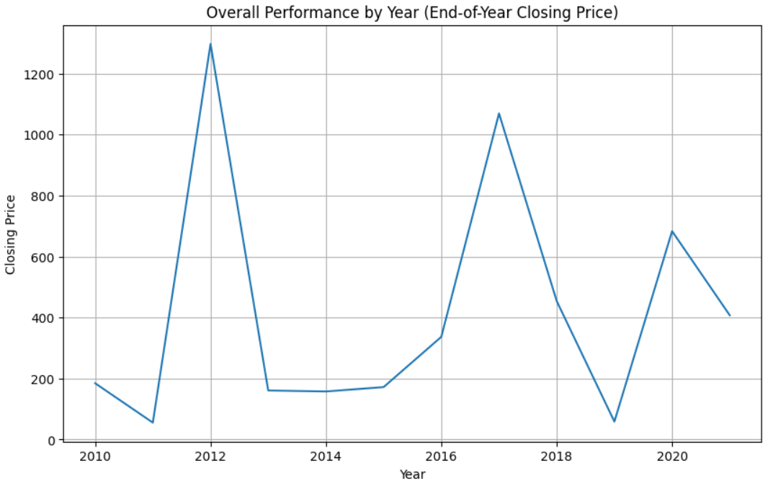
Q.6 What is the overall performance by year?
The Indian stock market, as represented by the Nifty 50 index in the dataset, has generally shown positive growth over the years, with some periods of decline and volatility. The market demonstrated resilience by recovering from downturns, particularly in 2021 and 2023. The consistent upward trend suggests positive long-term prospects for the Indian stock market.

Slide 10
Conclusion
Long-Term Growth Potential: The market has generally exhibited an upward trend over the observed period, suggesting long-term growth potential. However, this trend is interspersed with periods of decline and volatility, highlighting the inherent risk associated with stock market investments.
Volatility and Risk: The distribution of daily returns reveals significant volatility, with the possibility of substantial gains and losses within a single trading day. Investors should be prepared for price fluctuations and manage risk accordingly.
Normal Distribution with Fat Tails: The daily returns generally follow a normal distribution, but with heavier tails, indicating a higher likelihood of extreme returns compared to a perfect normal distribution. This suggests periods of increased volatility and larger price swings, making risk management crucial.
Seasonality: While some monthly variations exist, the average daily returns tend to be positive across most months, with certain months showing stronger positive returns on average. However, these patterns are not consistently predictable, and market conditions can change.
Extreme Values: The highest and lowest daily returns highlight the potential for significant gains and losses, emphasizing the importance of risk management strategies, such as diversification and stop-loss orders.
Market Efficiency: The approximate normal distribution of returns suggests a degree of market efficiency, where information is quickly reflected in prices, leading to random fluctuations around a central value.
External Factors: Market performance is influenced by various external factors, including economic news, global events, and policy changes. Investors should stay informed about these factors and adapt their strategies accordingly.
BUY
SELL

Slide 11
Thank You

